Slide 1
Phoetry
Abrianna Chianelli

Slide 2
Leave No Trace Maggie Dietz
Now the flowers are all folded, And the dark is going by. The evening is arising … It is time to rest. When I am sleeping I find my pillow full of dreams. They are all new dreams: No one told them to me Before I came through the cloud. They remember the sky, my little dreams, They have wings, they are quick, they are sweet. Help me tell my dreams To the other children, So that their bread may taste whiter, So that the milk they drink May make them think of meadows In the sky of stars. Help me give bread to the other children So that their dreams may come back: So they will remember what they knew Before they came through the cloud. Let me hold their little hands in the dark, The lonely children, The babies that have no mothers any more. Dear God, let me hold up my silver cup For them to drink, And tell them the sweetness Of my dreams.

Slide 3
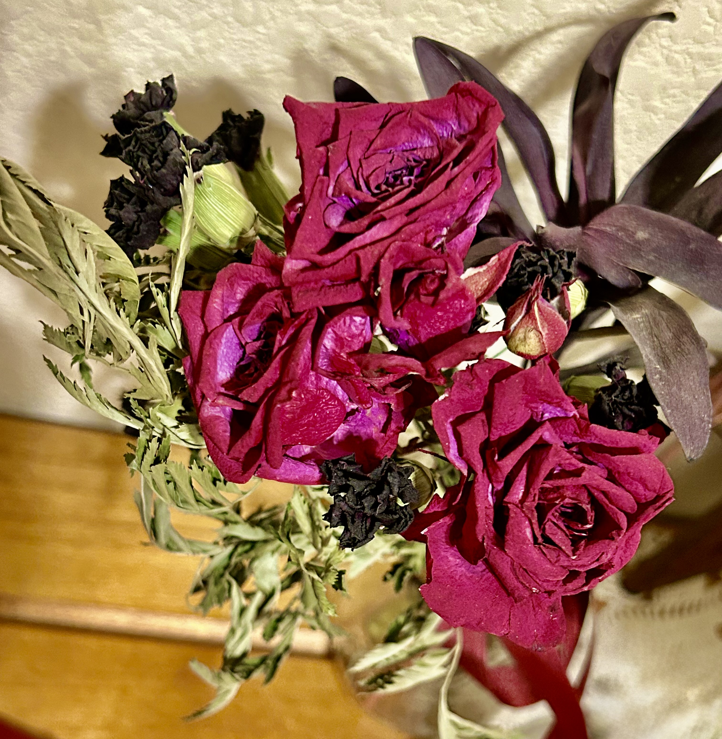
Now the flowers are all folded, And the dark is going by. The evening is arising … It is time to rest.

Slide 4
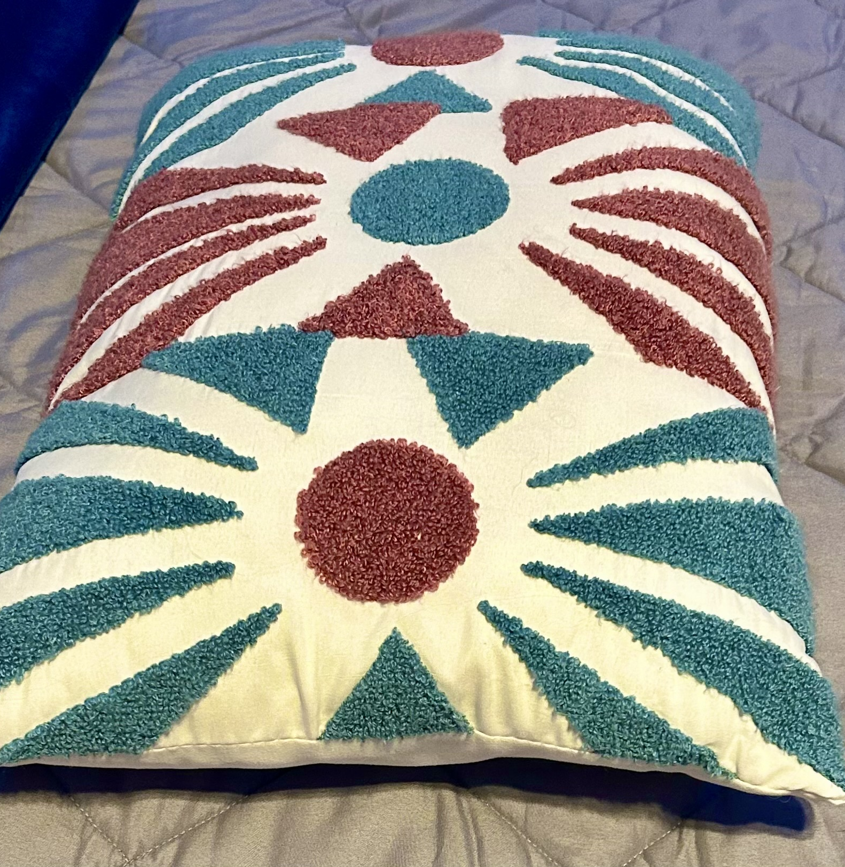
When I am sleeping I find my pillow full of dreams. They are all new dreams: No one told them to me Before I came through the cloud.

Slide 5
They remember the sky, my little dreams, They have wings, they are quick, they are sweet. Help me tell my dreams To the other children, So that their bread may taste whiter, So that the milk they drink May make them think of meadows In the sky of stars.

Slide 6
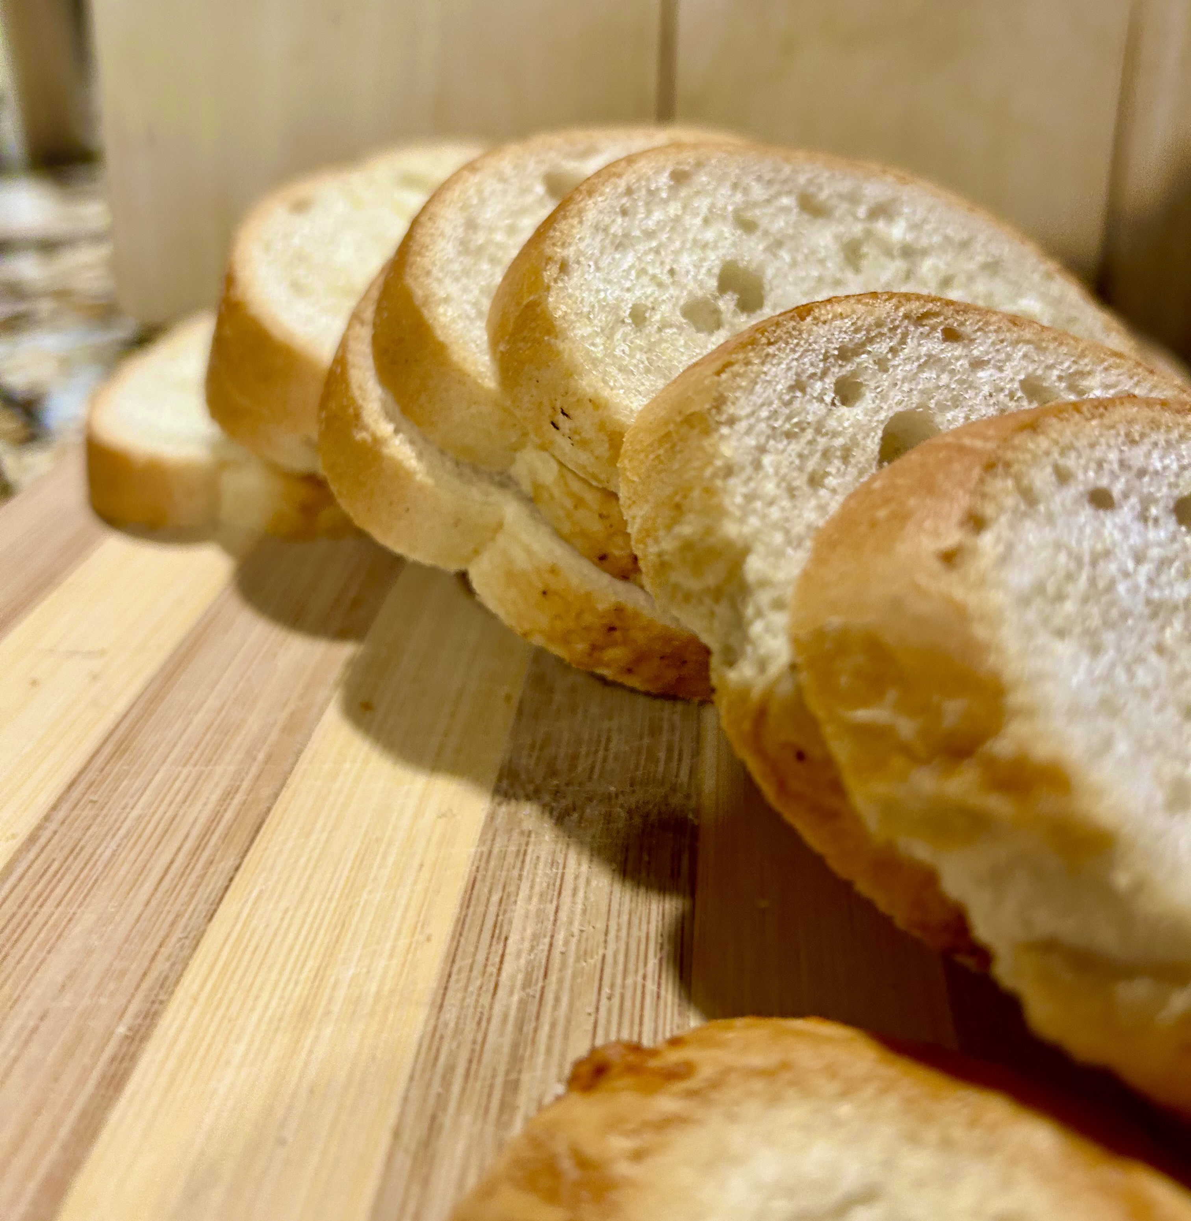
Help me give bread to the other children So that their dreams may come back: So they will remember what they knew Before they came through the cloud.

Slide 7
Let me hold their little hands in the dark, The lonely children, The babies that have no mothers any more. Dear God, let me hold up my silver cup For them to drink, And tell them the sweetness Of my dreams.

